Slide 1
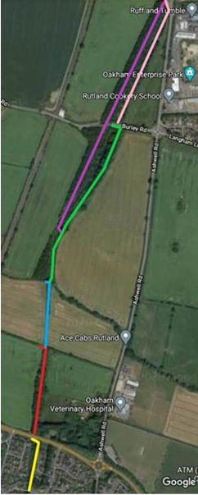
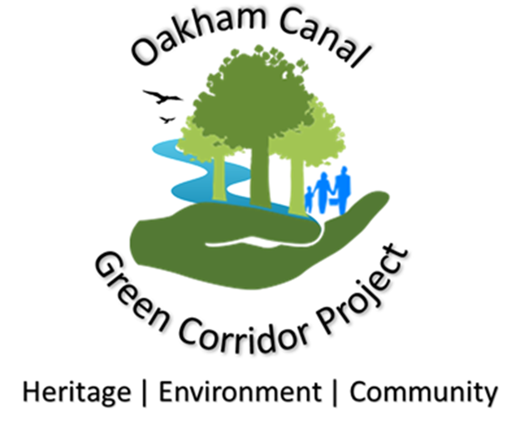
Oakham Canal Regeneration project
5
6
4
3
2
1

Slide 2
Project aim
To create and maintain an environmental and leisure “Green Corridor”, based upon the remains of the Oakham canal to the north of Oakham, which will:
Protect the original course of the Oakham Canal in the landscape as a recognised heritage asset;
Incorporate, protect, enhance, and maintain, a diverse range of wildlife habitats;
Incorporate, enhance and maintain public rights of way;
Provide opportunities for, and encourage participation in, a range of leisure activities, in a coherent linear park setting;
Increase public interest in, and awareness of, the Oakham Canal;
Provide learning opportunities about the canal and its history, as well as the environment and ecology that the Green Corridor provides;
Provide opportunities for community engagement and skills development through volunteer projects for the preservation of the heritage features of the Oakham Canal, as well as other environmental and conservation projects;
Allow interpretation to be provided for areas of special heritage, environmental or ecological interest; and
Offer the opportunity, through extension of the Project northwards, to create a long distance right of way towards Melton Mowbray and onwards into the Wreake valley.

Slide 3
Section 1
AIMS
Aim is to develop a maintenance strategy for this section that can be approved by RCC and "sold" to local residents. We would engage local residents in ongoing maintenance / care.
ACTIONS
Priority section for the project, but also the most sensitive due to the resident interface
Look to improve water quality of the existing pond – management plans for trees
Introduce community engagement
Look at the ash dieback issue
Suggest native species to replace flora currently in situ
Consider water level management options
Produce management plan to maintain and enhance the section
ECOLOGY
Cotoneaster (non-native decorative)
Laurel
Numerous waterbird sp.

Slide 4
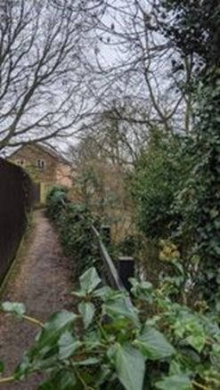
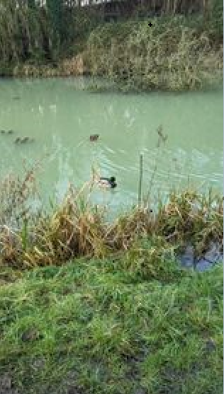
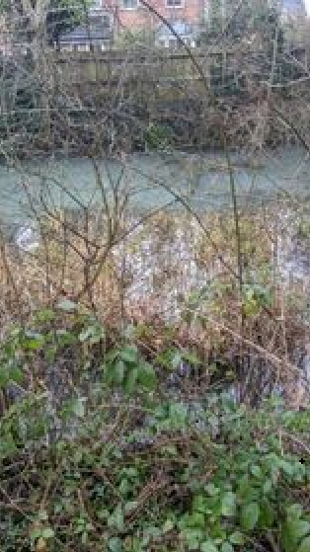
SECTION 1 - Photos

Slide 5
Section 2
AIMS
Focus on improving pathway through trees and re-routing official route to the field edge
Remove infected ash trees
Install boardwalk and viewing platforms
ACTIONS
As there is currently no public right of way on this section, we are currently in discussions with the landowner to see if there is a way to allow public access and allow the following actions to go ahead:
Survey trees to establish best course of action for the removal and management of unsafe trees
Look at the depth of the “swamp” in this section to establish best methods for installing boardwalk and viewing platforms
Engage community and create volunteer work party in order to manage section
Produce management plan to maintain the swap in its current state
Create scrapes to encourage amphibious population
ECOLOGY
Non-native cotoneaster species
Laurel
Jelly ear fungus
Small mammal holes
King Alfred cakes fungus
Potential woodpecker signs

Slide 6
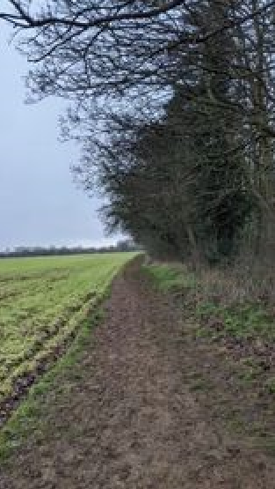
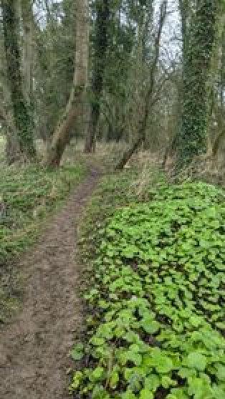
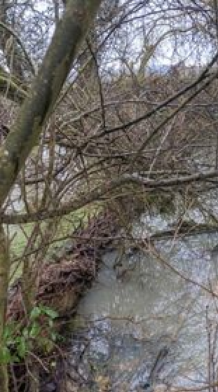
SECTION 2 - Photos

Slide 7
Section 3
AIMS
Manage hedgerow or liaise with the farmer to educate him towards more sympathetic management
Improve the pathway
ACTIONS
Produce hedgerow management plan
Suggest alternative native hedgerow species to enhance hedgerow
Encourage native planting
ECOLOGY
Small mammal holes
Species-poor hedgerow

Slide 8
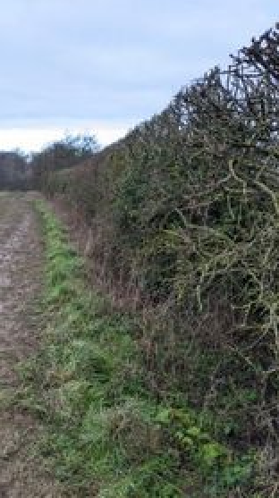
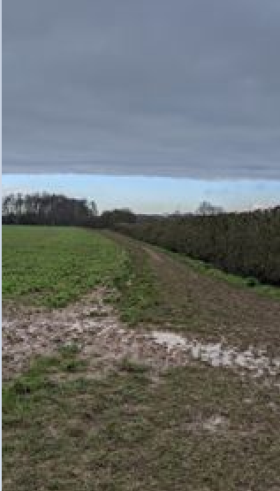
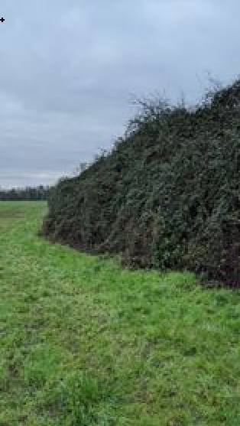
SECTION 3 - Photos

Slide 9
Section 4
AIMS
Manage this section in a way that is sympathetic to wildlife, but also importantly all users of the pathway (anglers, walkers etc)
ACTIONS
Reedbed management
Undertake protected species surveys to establish baseline of ecology for future monitoring
Produce management plan for ongoing maintenance and enhancement of section
Community engagement is particularly important to help the relationships between path users and the angling society – explain species interactions and health of the ecosystem and important of disturbance and management
ECOLOGY
Potential roosting features of bats identified on mature trees
Swans and various waterbird species present
Potential for water vole
Reedbed and scrub habitats

Slide 10
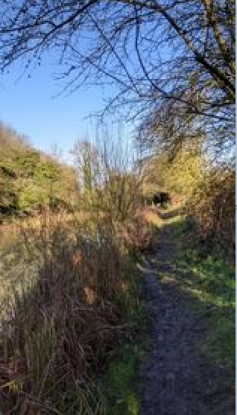
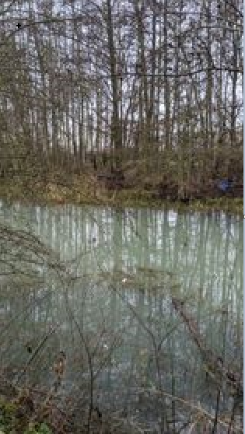
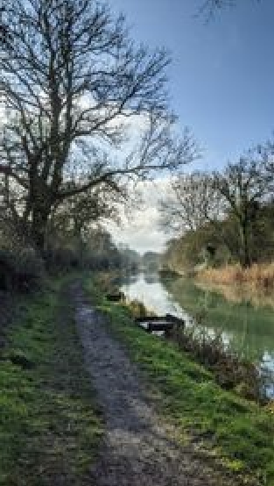
SECTION 4 - Photos

Slide 11
Section 5
AIMS
Manage pathway along the bank
Work with the angling society to achieve their aims, whilst being sympathetic to the native flora and fauna
Look at reedbed management
Improve biodiversity and water quality of the section
ACTIONS
Look into solutions to raise the pathway and sympathetically install fishing platforms
Undertake species surveys, priority for water vole and dragonfly
Produce long term management plan sympathetic to all path owners/users to enhance the current biodiversity
ECOLOGY
Hedgehog houses
Roe deer
Bat/bird boxes present
Broken waterbird egg
Freshwater mussel (eaten by heron)

Slide 12
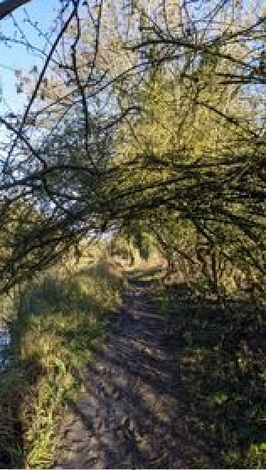
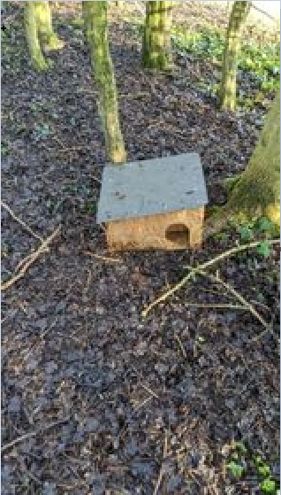
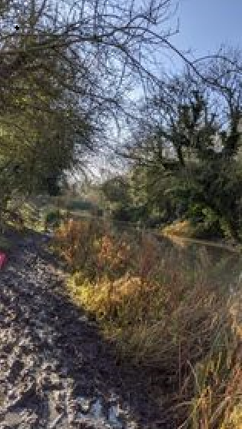
SECTION 5 - Photos

Slide 13
Section 6
AIMS
Maintain and enhance pathway
Mange and enhance scrubland
ACTIONS
Produce maintenance plan for the scrub and woodland
ECOLOGY
Semi-natural native woodland and scrub
Bat potential mature tree
Roe deer (faeces and tracks)
Badger sett

Slide 14
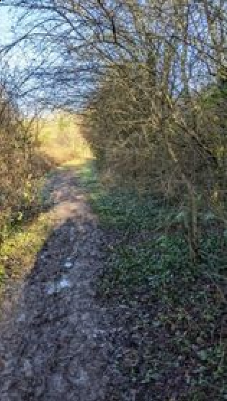
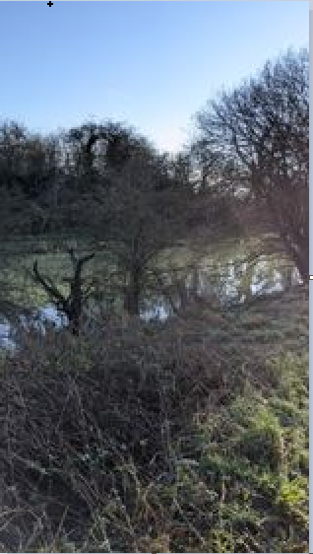
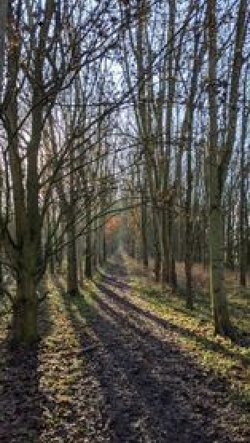
SECTION 6 - Photos

Slide 15
Next steps
Produce management plans for each section
Produce community engagement boards and install at the beginning of each section to explain the plans for the future – point them towards Facebook page and website
Plan in and undertake species surveys starting in March
Present solutions to maintenance and enhancement of footpaths and banks whilst enhancing biodiversity

